Slide 1
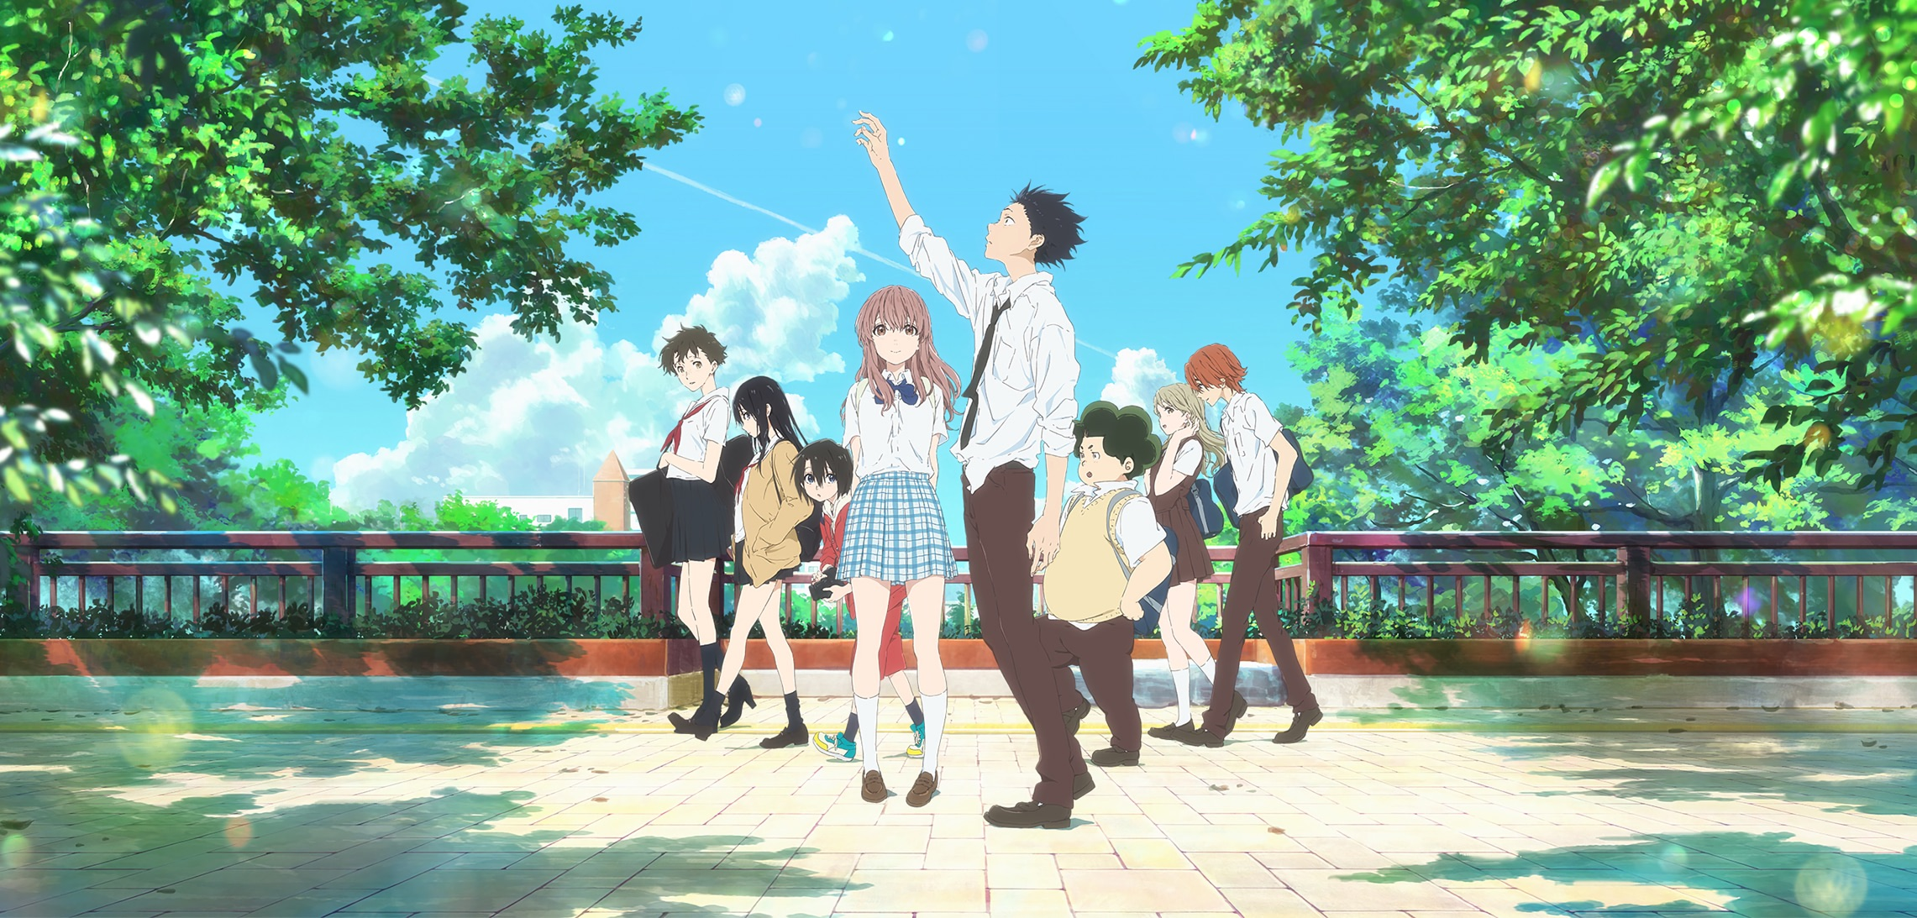
KOE NO KATACHI
(A SILENT VOICE)
映画 聲の形

Slide 2
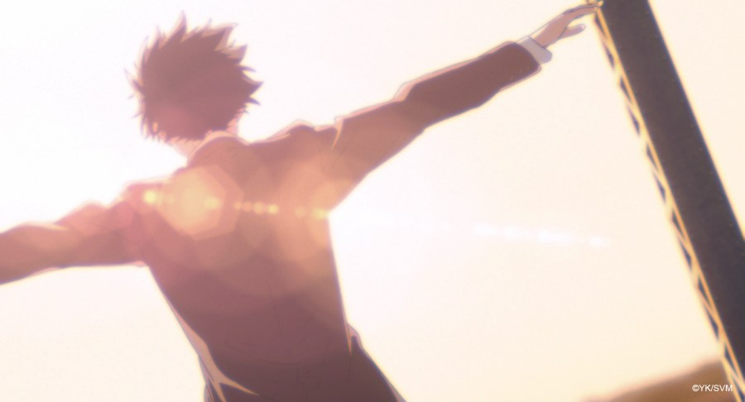
PLOT

Slide 3



FRIEND 1
FRIEND 2
FRIENDetc
Nishimiya Shouko

Slide 4
FRIEND 1
FRIEND 2
FRIENDetc

Slide 5
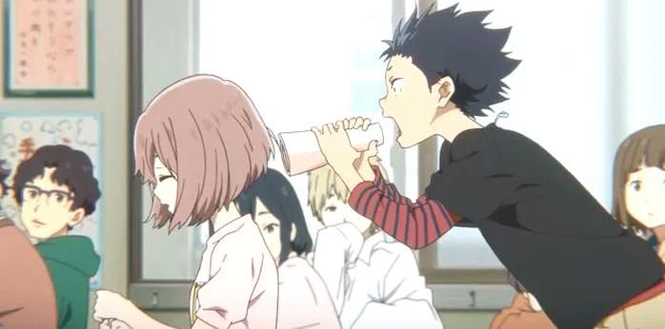
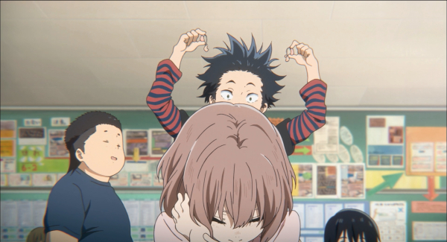
FRIEND 1
FRIEND 2
FRIENDetc

Slide 6
Teacher
FRIEND 1
FRIEND 2
FRIENDetc

Slide 7


Slide 9
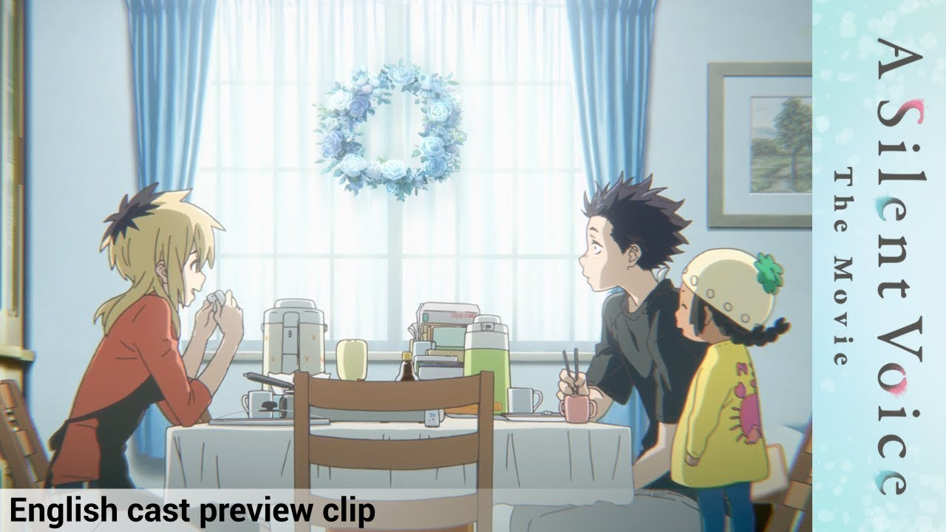

Slide 10


Slide 11
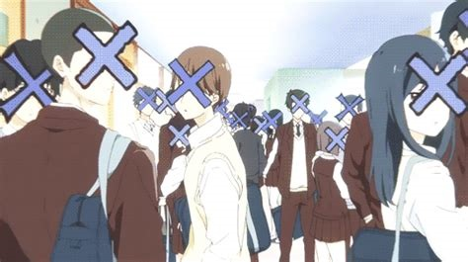

Slide 12
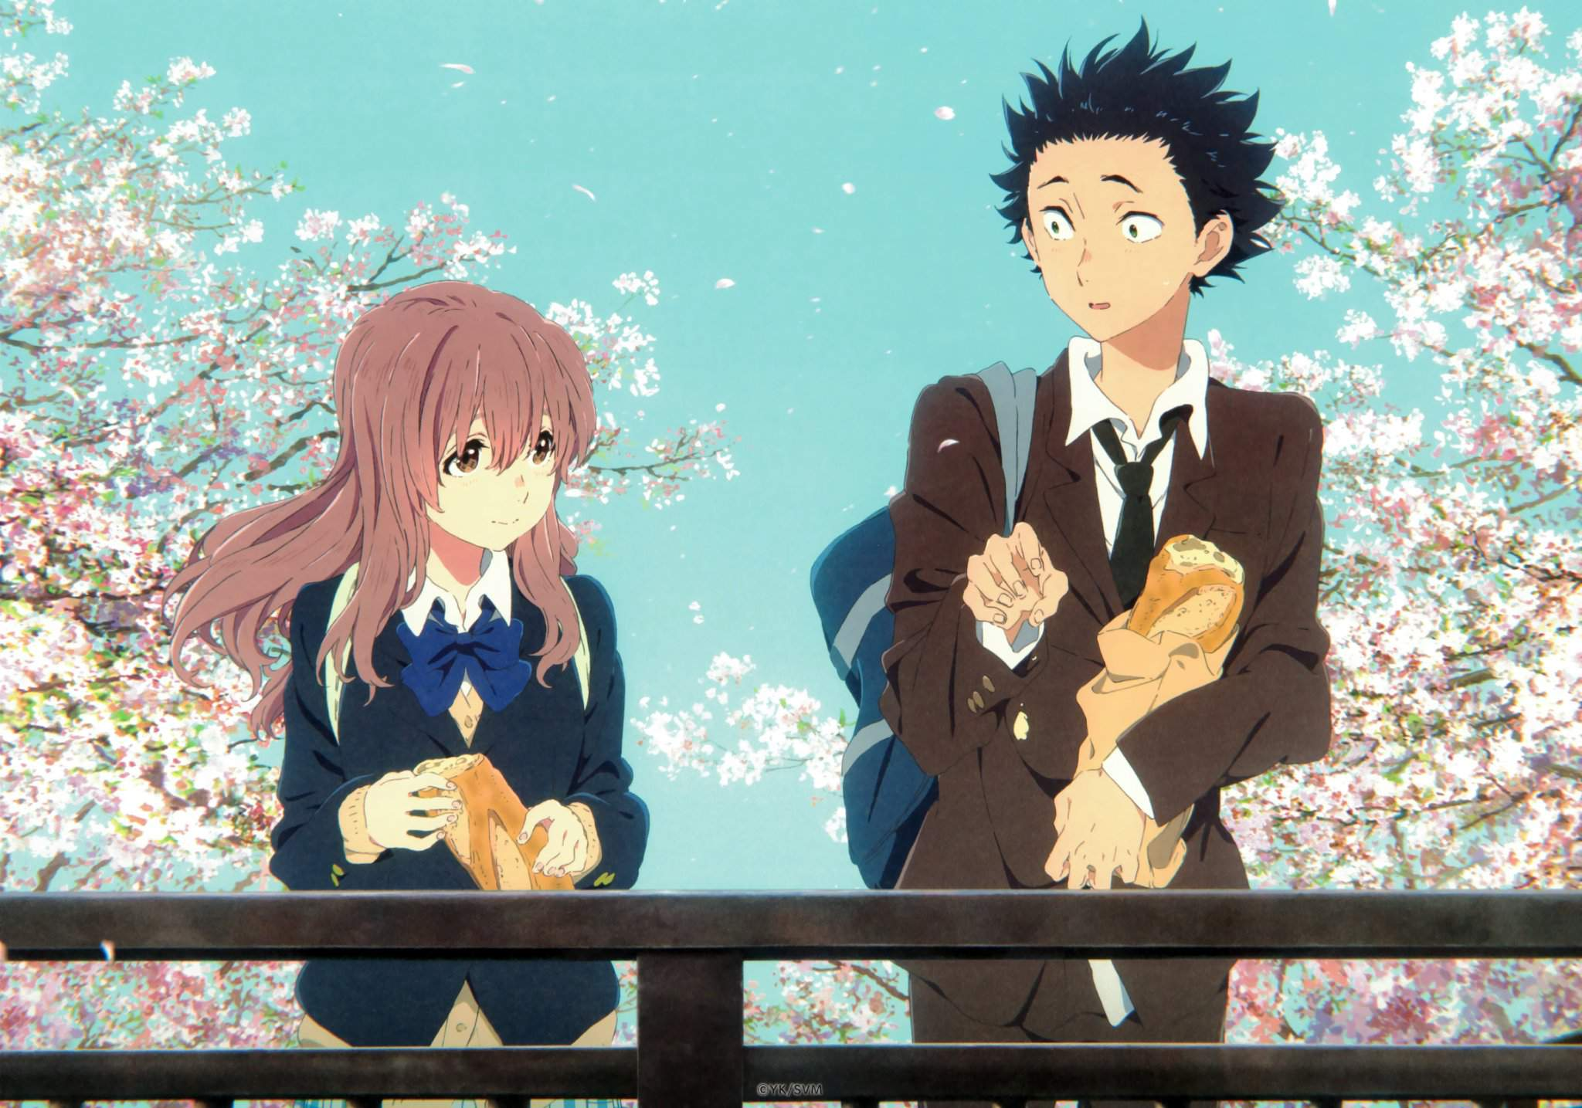

Slide 13
Bullies
NISHIMIYA
NAOKA
Starts blaming herself

Slide 14
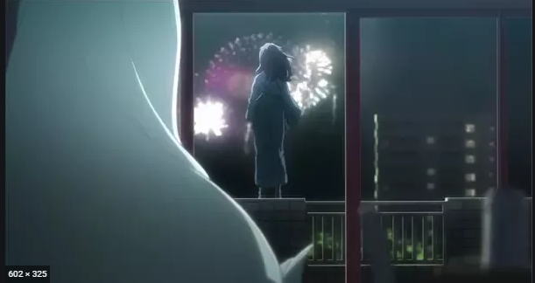

Slide 15
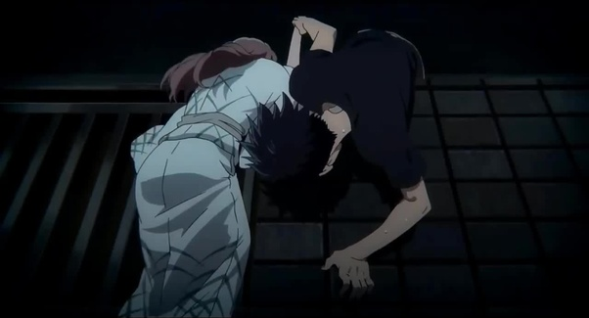

Slide 16
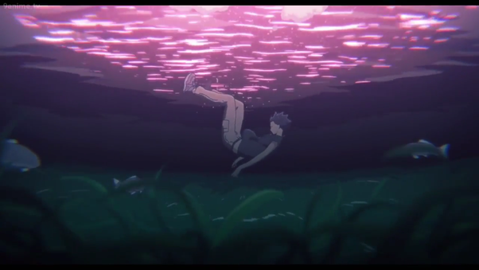

Slide 17
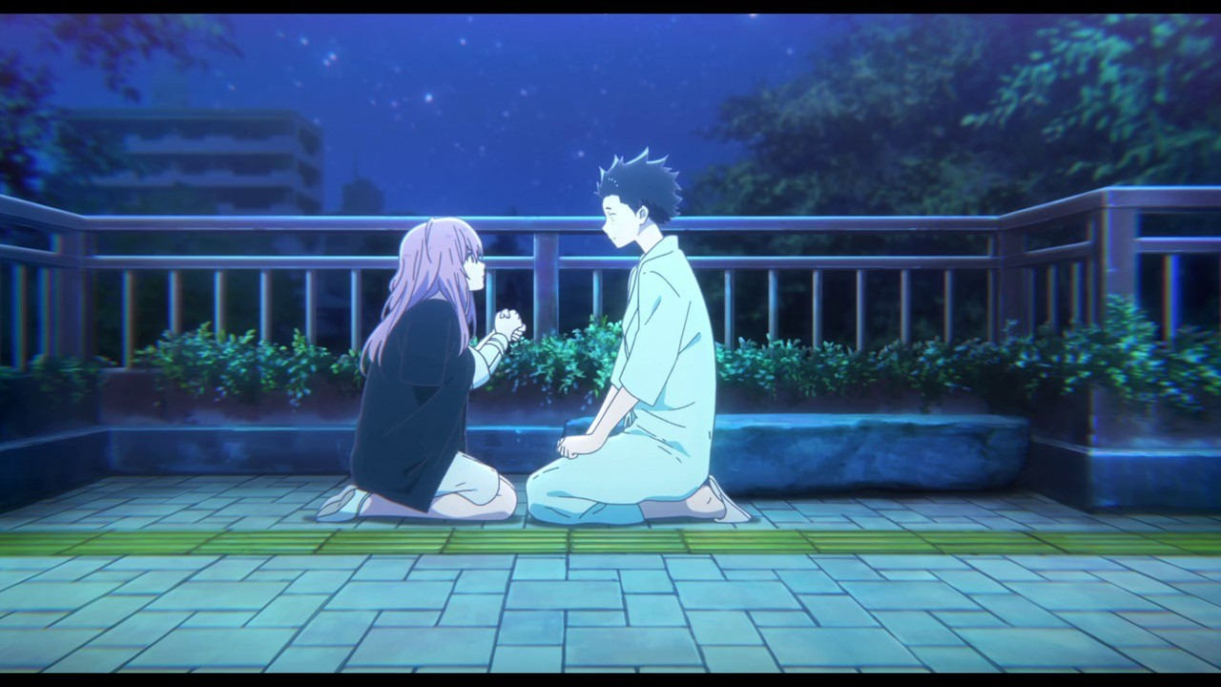

Slide 18


Slide 19
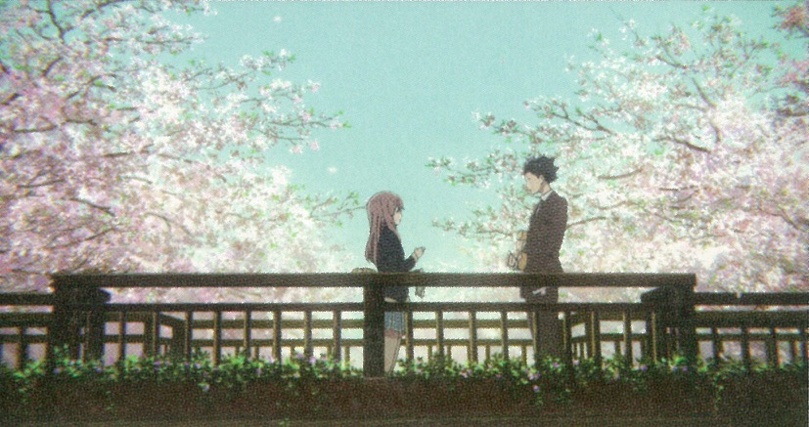
What does the Movie try to convey??
How the “different” are treated indifferently.
Social anxiety due to guilt.
The complexity of human emotions.

Slide 20
HOW THE “DIFFERENT” ARE TREATED DIFFERENTLY.
Not everyone will react in the same way.
Not everyone will continue to behave towards you as they used to.
DISABILITY DISCRIMINATION

Slide 21
SOCIAL ANXIETY.

Slide 22
THE COMPLEXITY OF HUMAN EMOTIONS.
Mark Manson.
In His Second Book.
The Newton’s Laws of emotions.
For Every Action, There is an Equal and Opposite Emotional Reaction.
Our Self-Worth Equals the Sum of Our Emotions Over Time.
Your Identity Will Stay Your Identity Until a New Experience Acts Against It.

Slide 23

The Movies message.
In Short.
Hope. Don’t bully others and most importantly don’t bully yourself and don’t be too hard on yourself.

